Slide 1
EIG Engineering Services
Industry-leading Services that Enable Customers to Maximize Their Energy Monitoring Investments
E300759 Rev 3 052124 Copyright © Electro Industries/GaugeTech All Rights Reserved

Slide 2
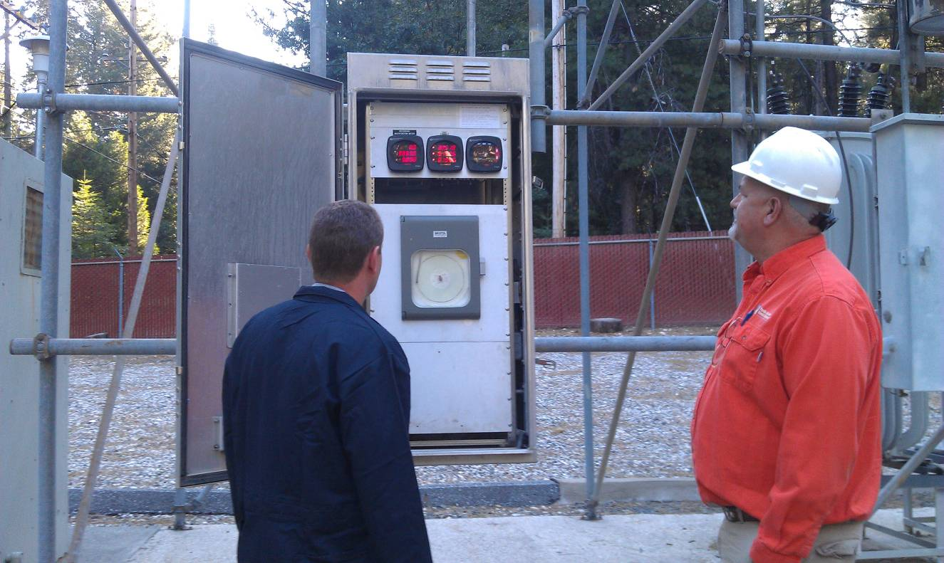
Why Use EIG Engineering Services?
EIG’s engineers are available to work with customers directly, to fit their needs.
EIG’s Engineering Services team consists of highly experienced and talented engineers with a variety of skills in the fields of electrical engineering, software engineering, and meter engineering.
Engineering Services can assist in commissioning, start up verification, and certification of installations.
Engineering Services has a group of system integration engineers that can create custom SCADA (HMIPQA+™) or other energy management software applications that fit the customer’s specific requirements.
When training is needed, EIG can support you with onsite or webinar training that covers all EIG solutions. Training staff are certified RCEP instructors.

Slide 3
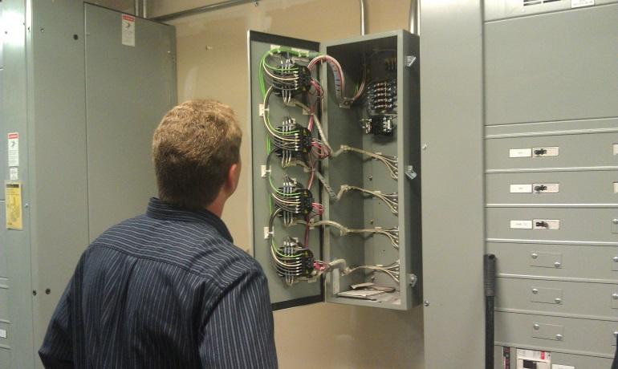
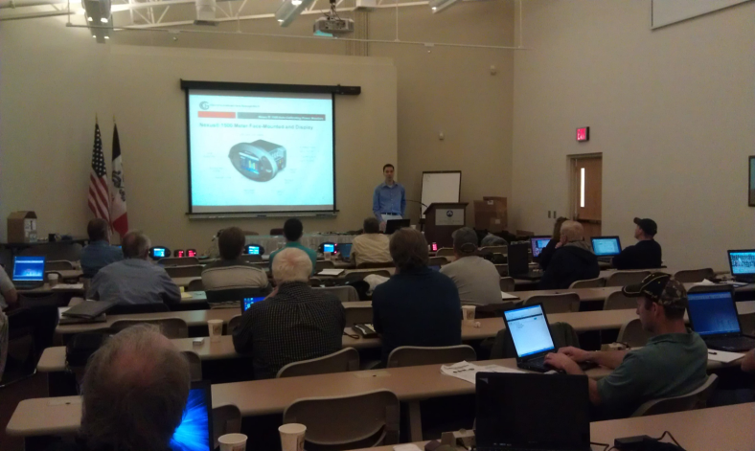
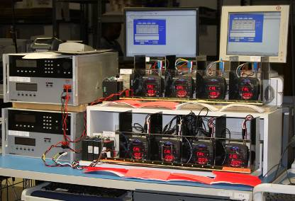
SERVICES WE PROVIDE
Onsite consulting and commissioning.
System integration.
Onsite customer training.
Factory-based meter calibration services.
Free email and phone support.

Slide 4
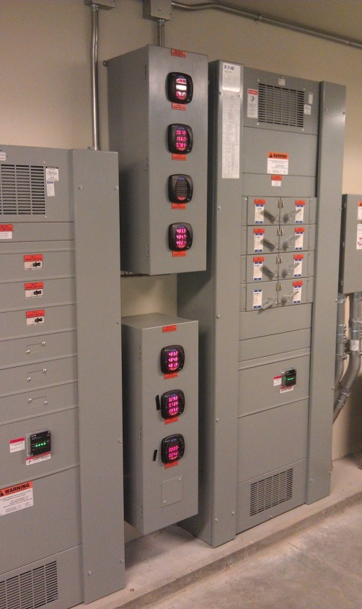
ONSITE COMMISSIONING
Engineers are available on an hourly or daily basis. Typical commissioning assistance includes:
Verifying meter installation and wiring.
Verifying proper system integration.
Working with third parties to ensure cross compatibility.
Advising users on best practices for optimal implementation.
Engineers can also assist with troubleshooting and correcting preinstalled systems, including those not manufactured by EIG.
A single vendor provides assurance of a successful project. EIG will be a partner in that success.
The EIG team goes to work on your schedule to get the project up and running, within your budget and time requirements. Our goal is to work within your schedule to meet your project deadline.

Slide 5
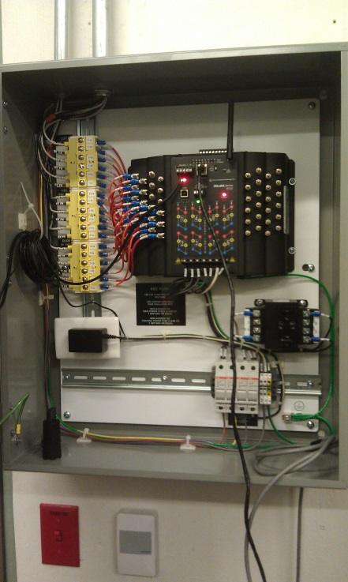
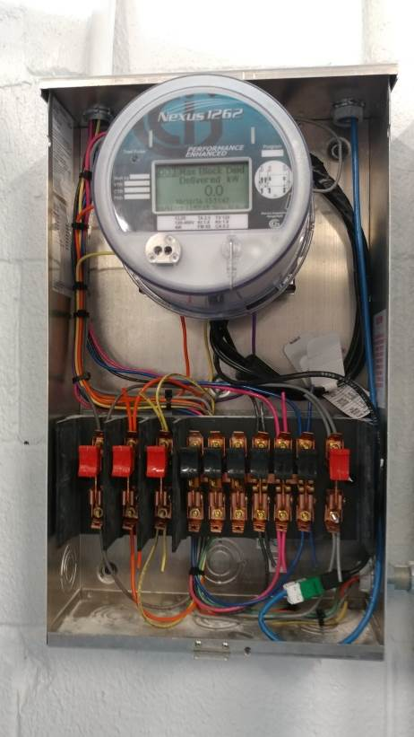
SYSTEM INTEGRATION
When developing custom applications, such as SCADA and HMI systems, it is critical to use a team that has the experience to get the job done properly.
EIG has successfully integrated many SCADA systems using its HMIPQA+™ software architecture.
EIG’s system integration customers choose EIG because:
EIG stands behind its customized applications.
The EIG team is ready whenever expansion and other integration is required.

Slide 6
SAMPLING OF OUR SYSTEM INTEGRATION CUSTOMERS
.
Austin Community College, Austin, Texas:
Initial validation and configuration of multiple meters.
Worked with the Siemens team to integrate data from meters into the SCADA system.
Goldman Sachs, Salt Lake City, Utah:
Integration into Building Management System (BMS) and consequent validation.
Idaho National Laboratory, Idaho Falls, Idaho:
Site energy plan and integration into Energy Management System (EMS).
El Paso Airport, El Paso, Texas:
Integration of power meters to measure gate energy usage for billing of airlines.
Metro Link Rail System, Los Angeles, California:
Integration of emergency power system metering for Positive Control System for the LA Basin.

Slide 7
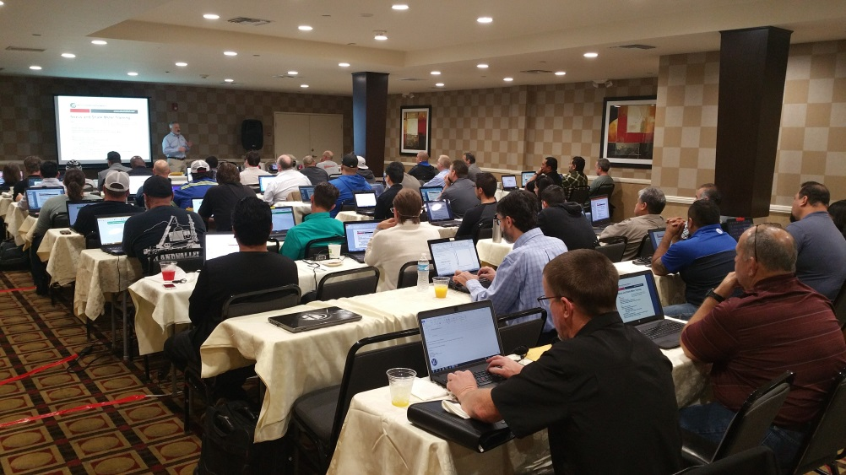
ONSITE TRAINING
Training is essential to implementing a new project successfully.
EIG offers regular training. Training helps users by educating them on all aspects of the life cycle of metering systems, from installation to on-going use.
Engineering Services can create a custom class that meets your exact requirements and covers the EIG products you will be using, giving your team the necessary knowledge and skills.
EIG can provide either onsite or webinar training on metering products, software, and/or SCADA, so that users will be knowledgeable on all aspects of the products.
Instructors are RCEP (Registered Continuing Education Program) certified. All training can be certified for continuing education credits.

Slide 8
METER CALIBRATION AND CERTIFICATION
Some applications require that equipment is tested yearly. EIG has the capability to field test meters and provide an accuracy report.
Testing services are available for any electrical energy revenue meter that has a test pulse.
EIG’s Engineering Services will test these meters either onsite or at our Westbury, N.Y. factory.

Slide 9
BENEFITS OF USING EIG’S ENGINEERING SERVICES TEAM
EIG’s engineers are experts in our products.
EIG’s engineers understand best the systems that our products integrate with.
Using EIG’s Engineering Services team saves you time and money.
You can have confidence that all the data and other information from your system is accurate.

Slide 10
NEXT STEPS
.
EIG has a full team of sales and application engineering professionals who are available to help recommend and design the correct solution for most metering requirements.
Contact EIG’s Technical Services team at 516-334-0870 or email support@electroind.com to learn about pricing for services and to schedule an appointment.

Slide 11
CONTACT INFORMATION
.
Our Web address is: www.electroind.com.
Full brochures, instruction manuals, guide form specifications and CAD drawings are available at this site for every product in EIG’s portfolio.
Address: Electro Industries / GaugeTech 1800 Shames Drive Westbury, NY 11590 (516)-334-0870 (Tel) (516)-338-4741 (Fax)
Email: Sales@electroind.com.
Join us on LinkedIn: https://www.linkedin.com/company/electro-industries/.
Link to us on Facebook: https://www.facebook.com/pages/Electro-Industries/622424921119819.
Follow us on Twitter: https://twitter.com/electroind.

